Slide 1

PROCURA
Development of Smart Procurement & Purchase Order Management System

Slide 2
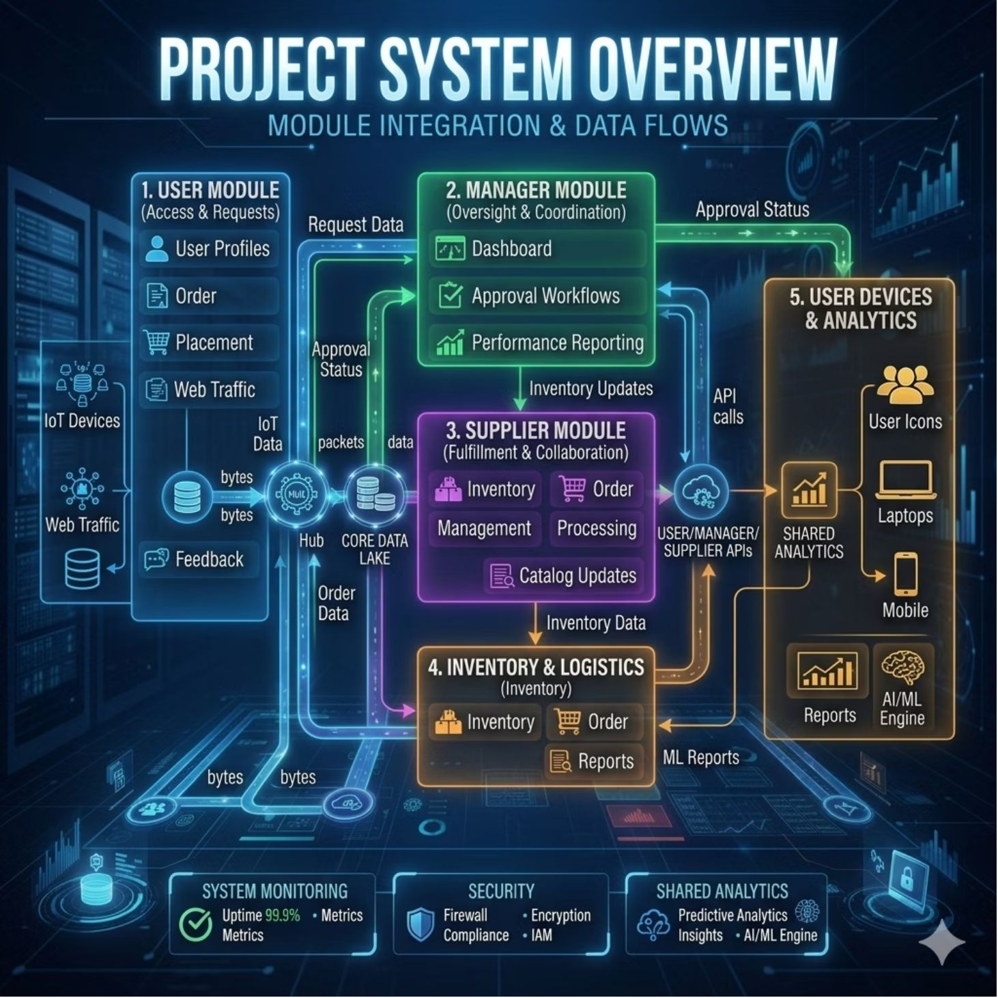
System Overview
A unified platform for modern procurement
PROCURA is a full-stack web application that digitizes and centralizes the entire procurement lifecycle — from product browsing to payment and reporting.
Centralized workflow for requests, approvals, payments, tracking, and transparent feedback across all stakeholders.

Slide 3
PROCURA: Technology Stack
PROCURA is built on a focused technology stack designed for a clean user experience, reliable backend performance, and streamlined communication.
Frontend (React)
Backend (Spring Boot)
Dynamic, component-based user interfaces for an intuitive and responsive experience.
A fast, scalable backend framework for handling business logic and application services.

Slide 4
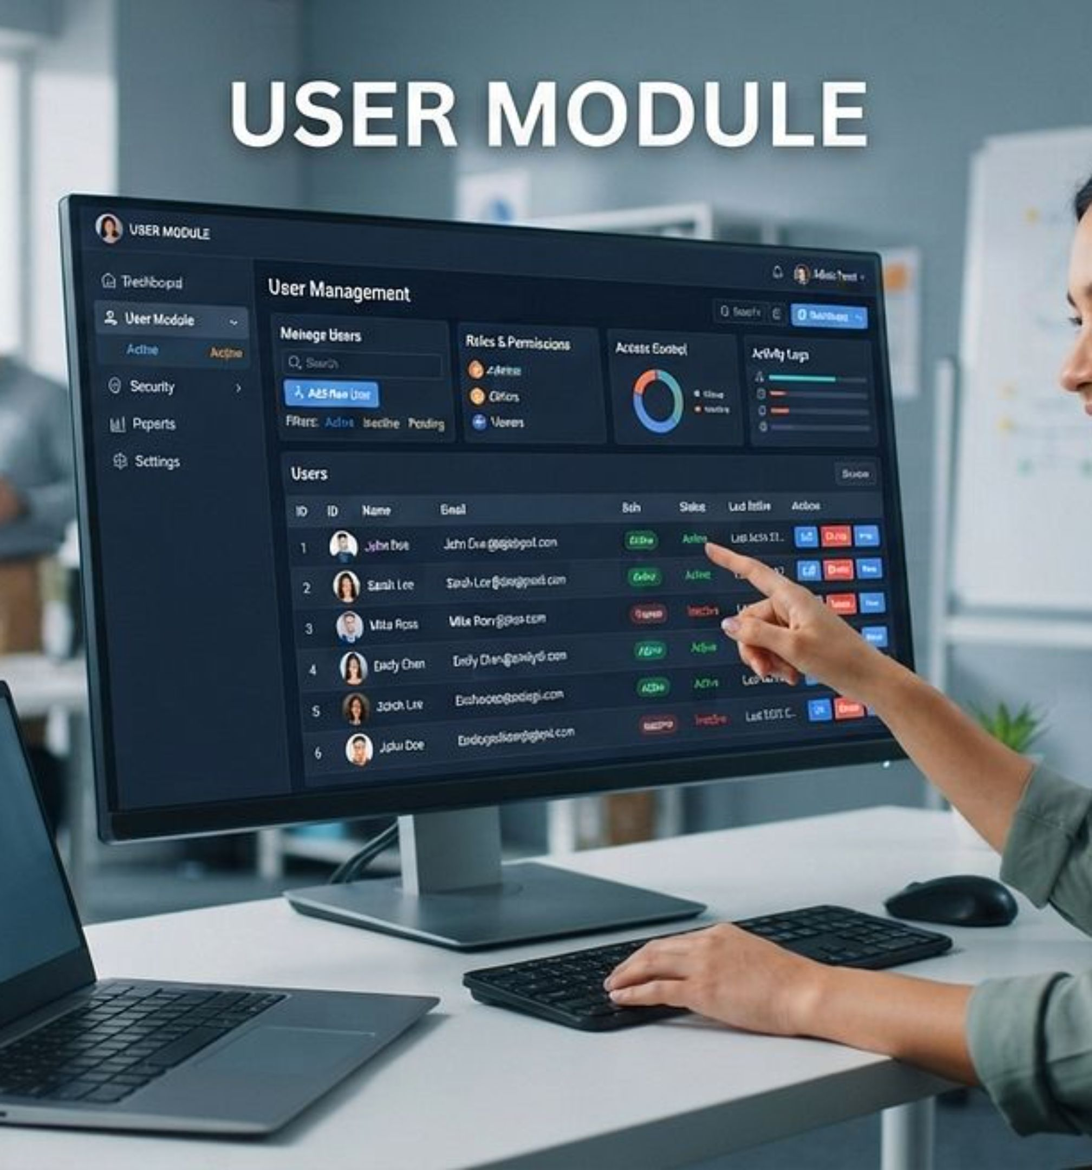
User Module
Empowering employees to browse, request, track, and report — all in one place.

Slide 5
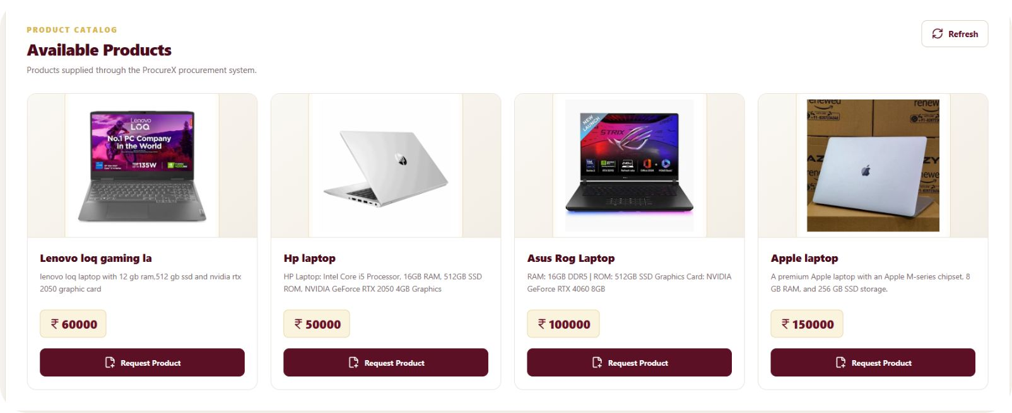
Browse Products & Catalog
Explore with confidence
Comprehensive product catalog with detailed specifications
View pricing, availability, and product reviews at a glance
Filter by category, department, and specifications for precise discovery

Slide 6
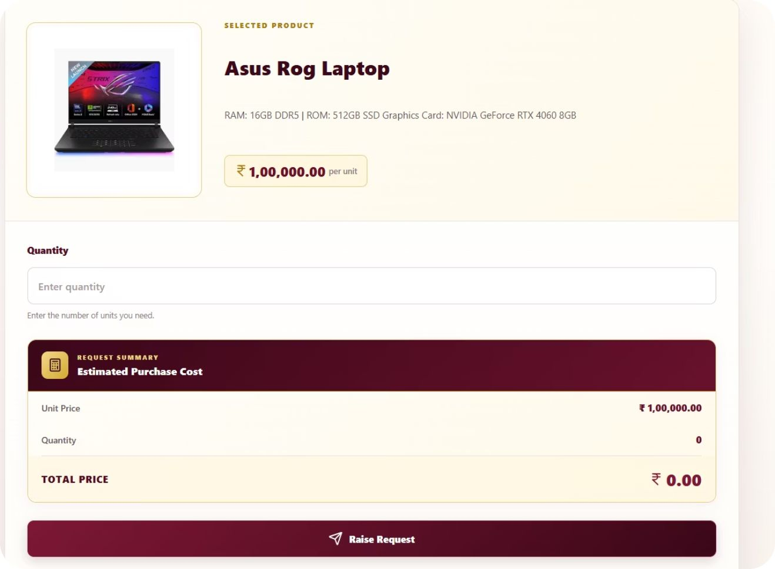
Raise Purchase Requests
Submit
Calculate
Product requests with quantity and full specifications
Automatic cost calculation and purchase summary
Track
Real-time request status from submission onward

Slide 7
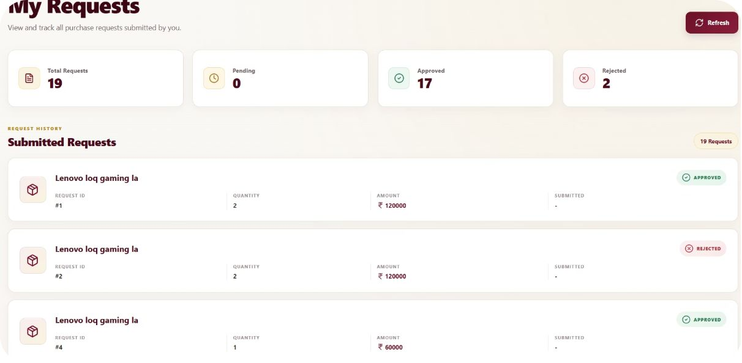
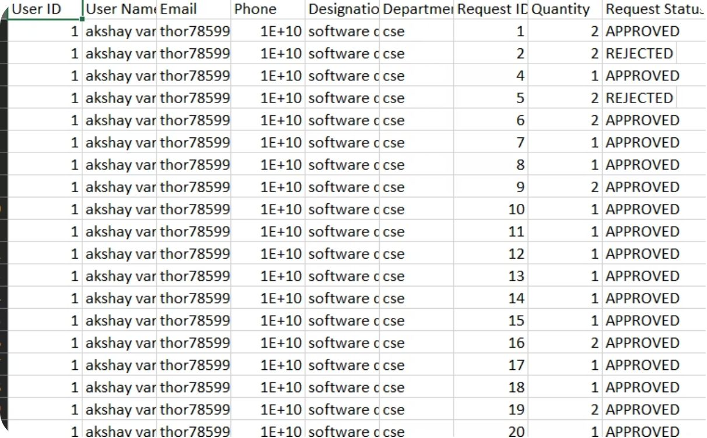
My Requests Dashboard & CSV Reports
Centralized Request Hub
All submitted requests in one dashboard
Approval status breakdown at a glance
Quick access to request history
Export & Record-Keeping
Export request data as CSV for offline access
Includes user info, product details, quantities & status
Maintain a complete procurement history

Slide 8
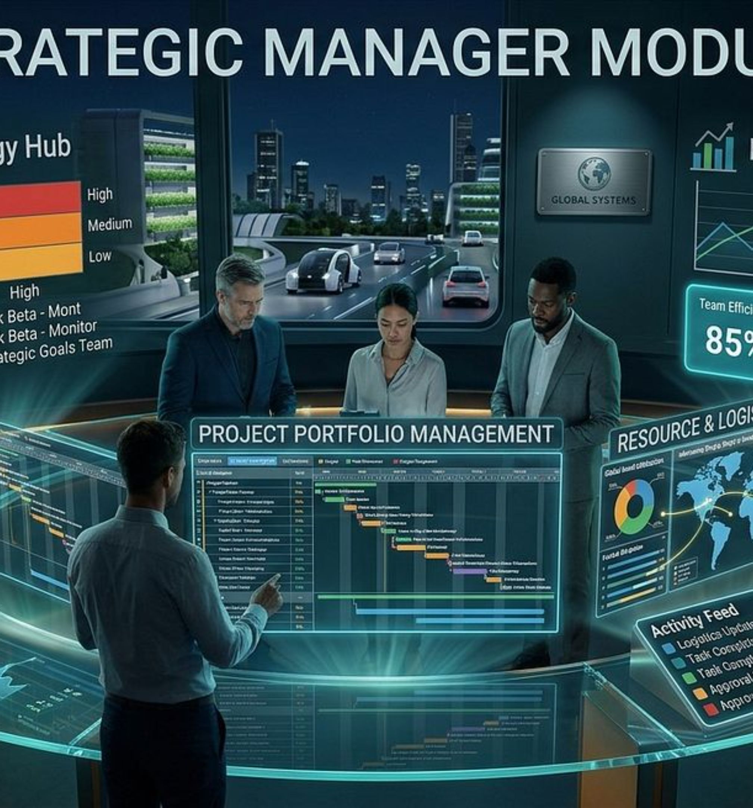
CHAPTER 2
Manager Module
Oversight, control, and informed decision-making across all procurement requests.

Slide 9
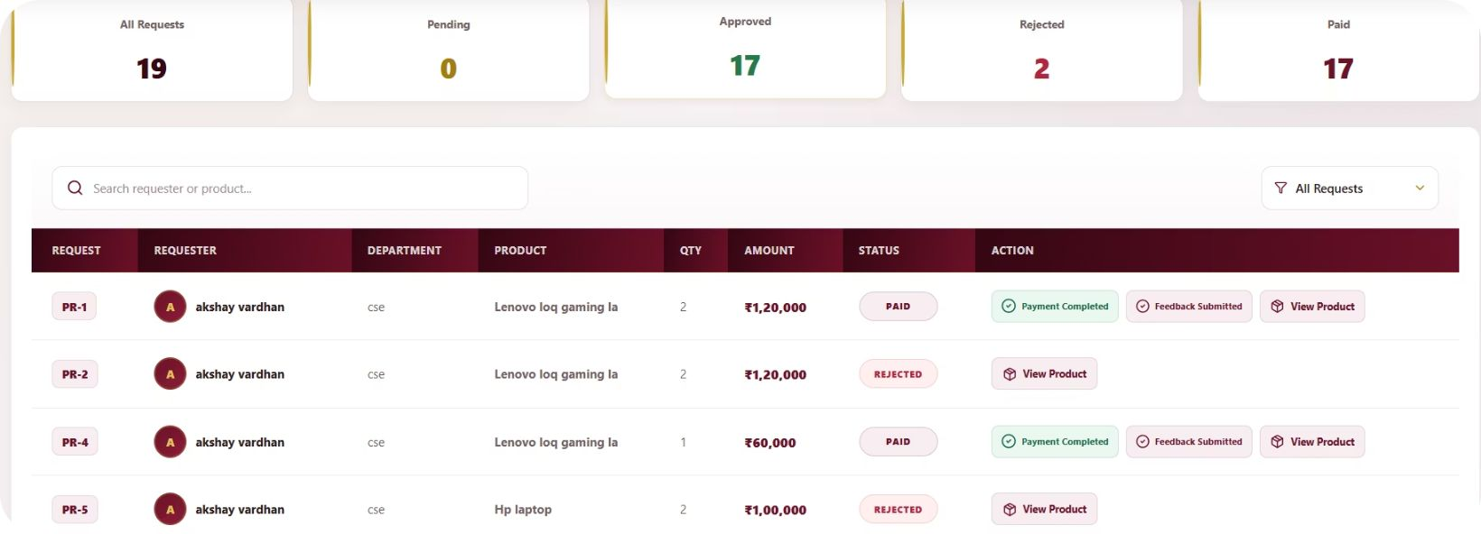
Approve or Reject Requests
Informed decision-making
Managers receive a complete view of every pending purchase request — including product details, quantities, requester information, and cost breakdowns.
Review pending requests with full contextual details
Approve or reject with structured feedback comments

Slide 10
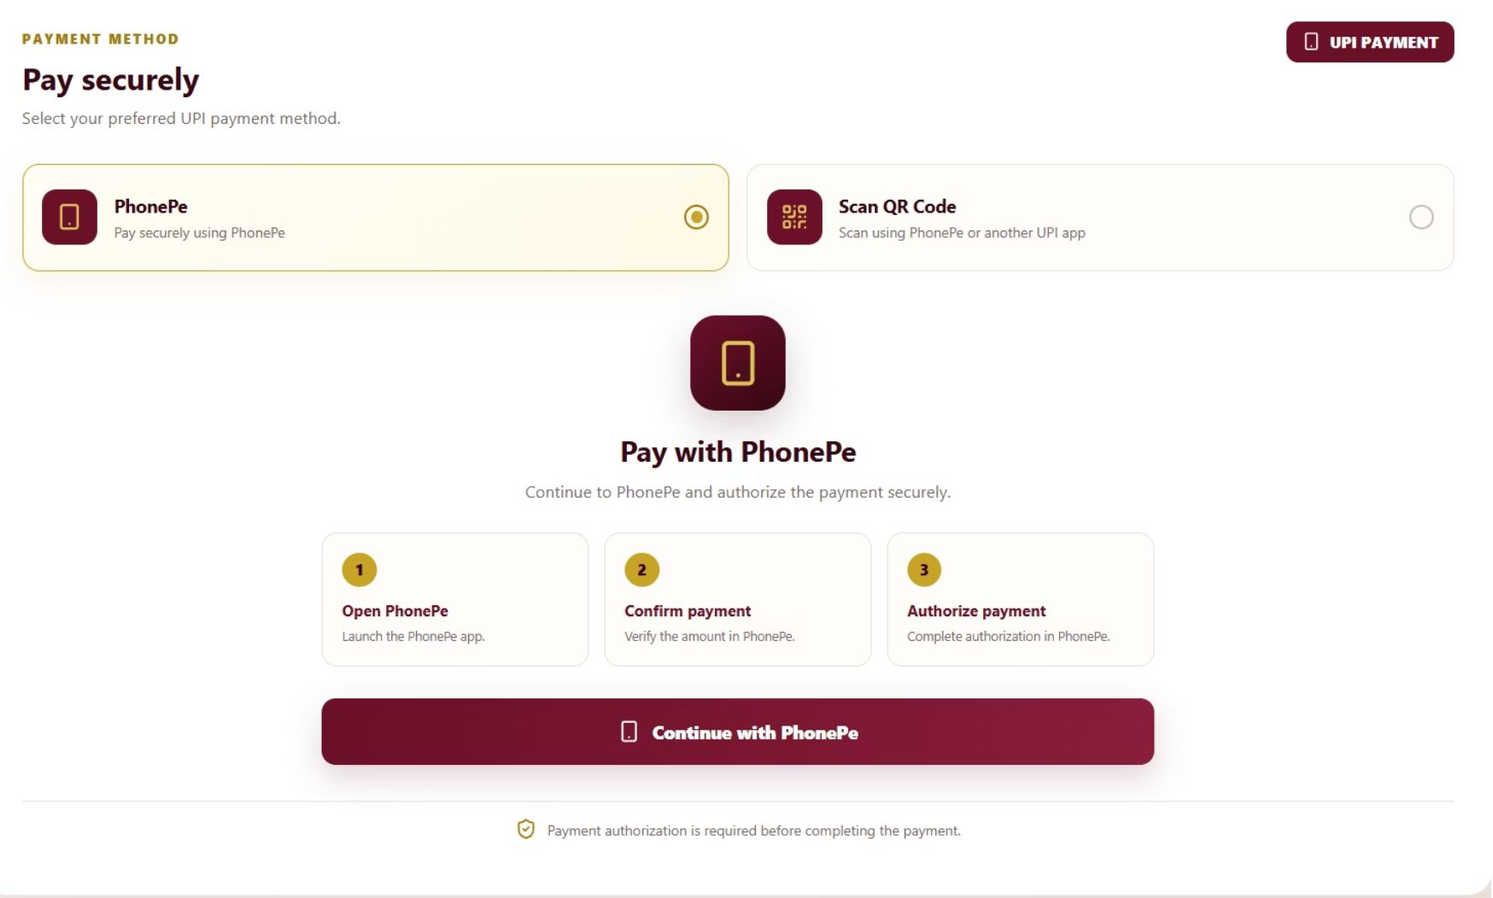
Process Payments
Secure payment processing with multiple methods
PhonePe integration for seamless transactions
Payment confirmation and authorization workflow

Slide 11
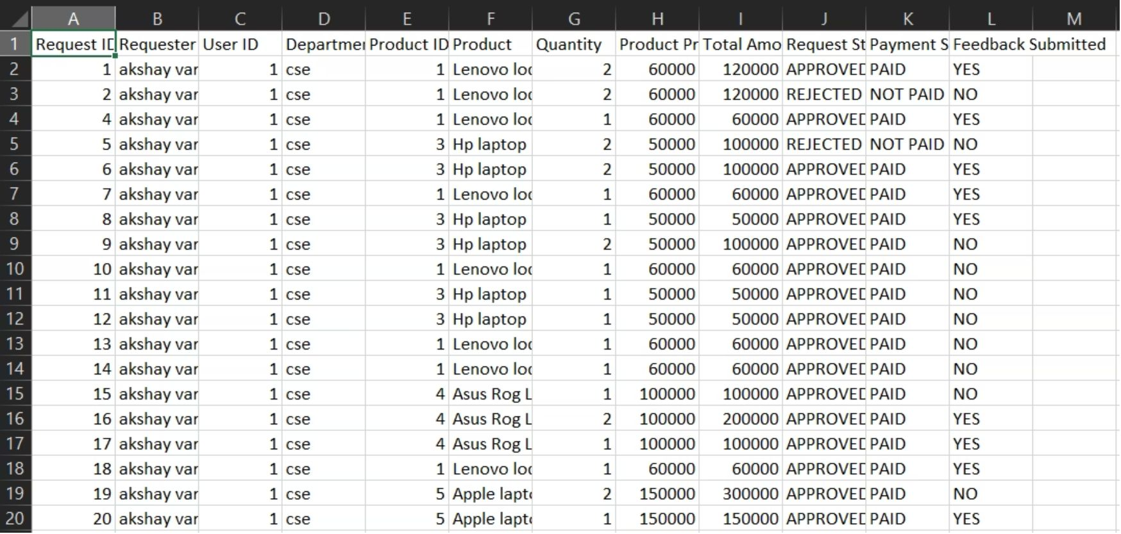
Manager CSV Reports
Export comprehensive approval and payment data
Track request approvals, rejections, and feedback
Generate reports for compliance and auditing

Slide 12
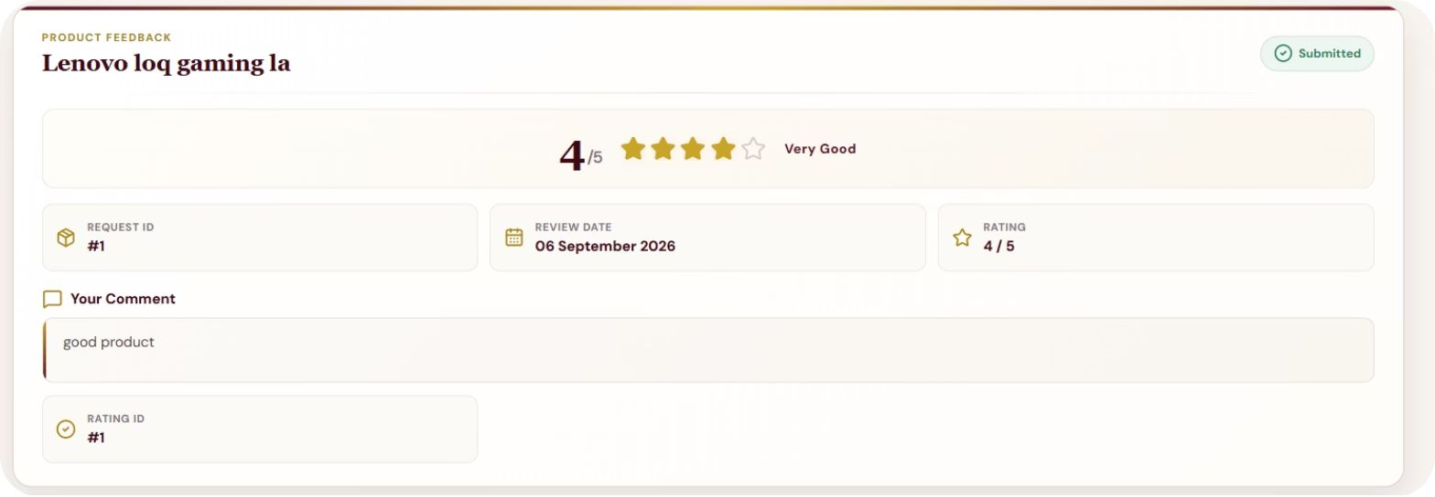
Provide Feedback & Reviews
Submit feedback on product quality and delivery
Rate supplier performance and service
Contribute to transparent review system

Slide 13
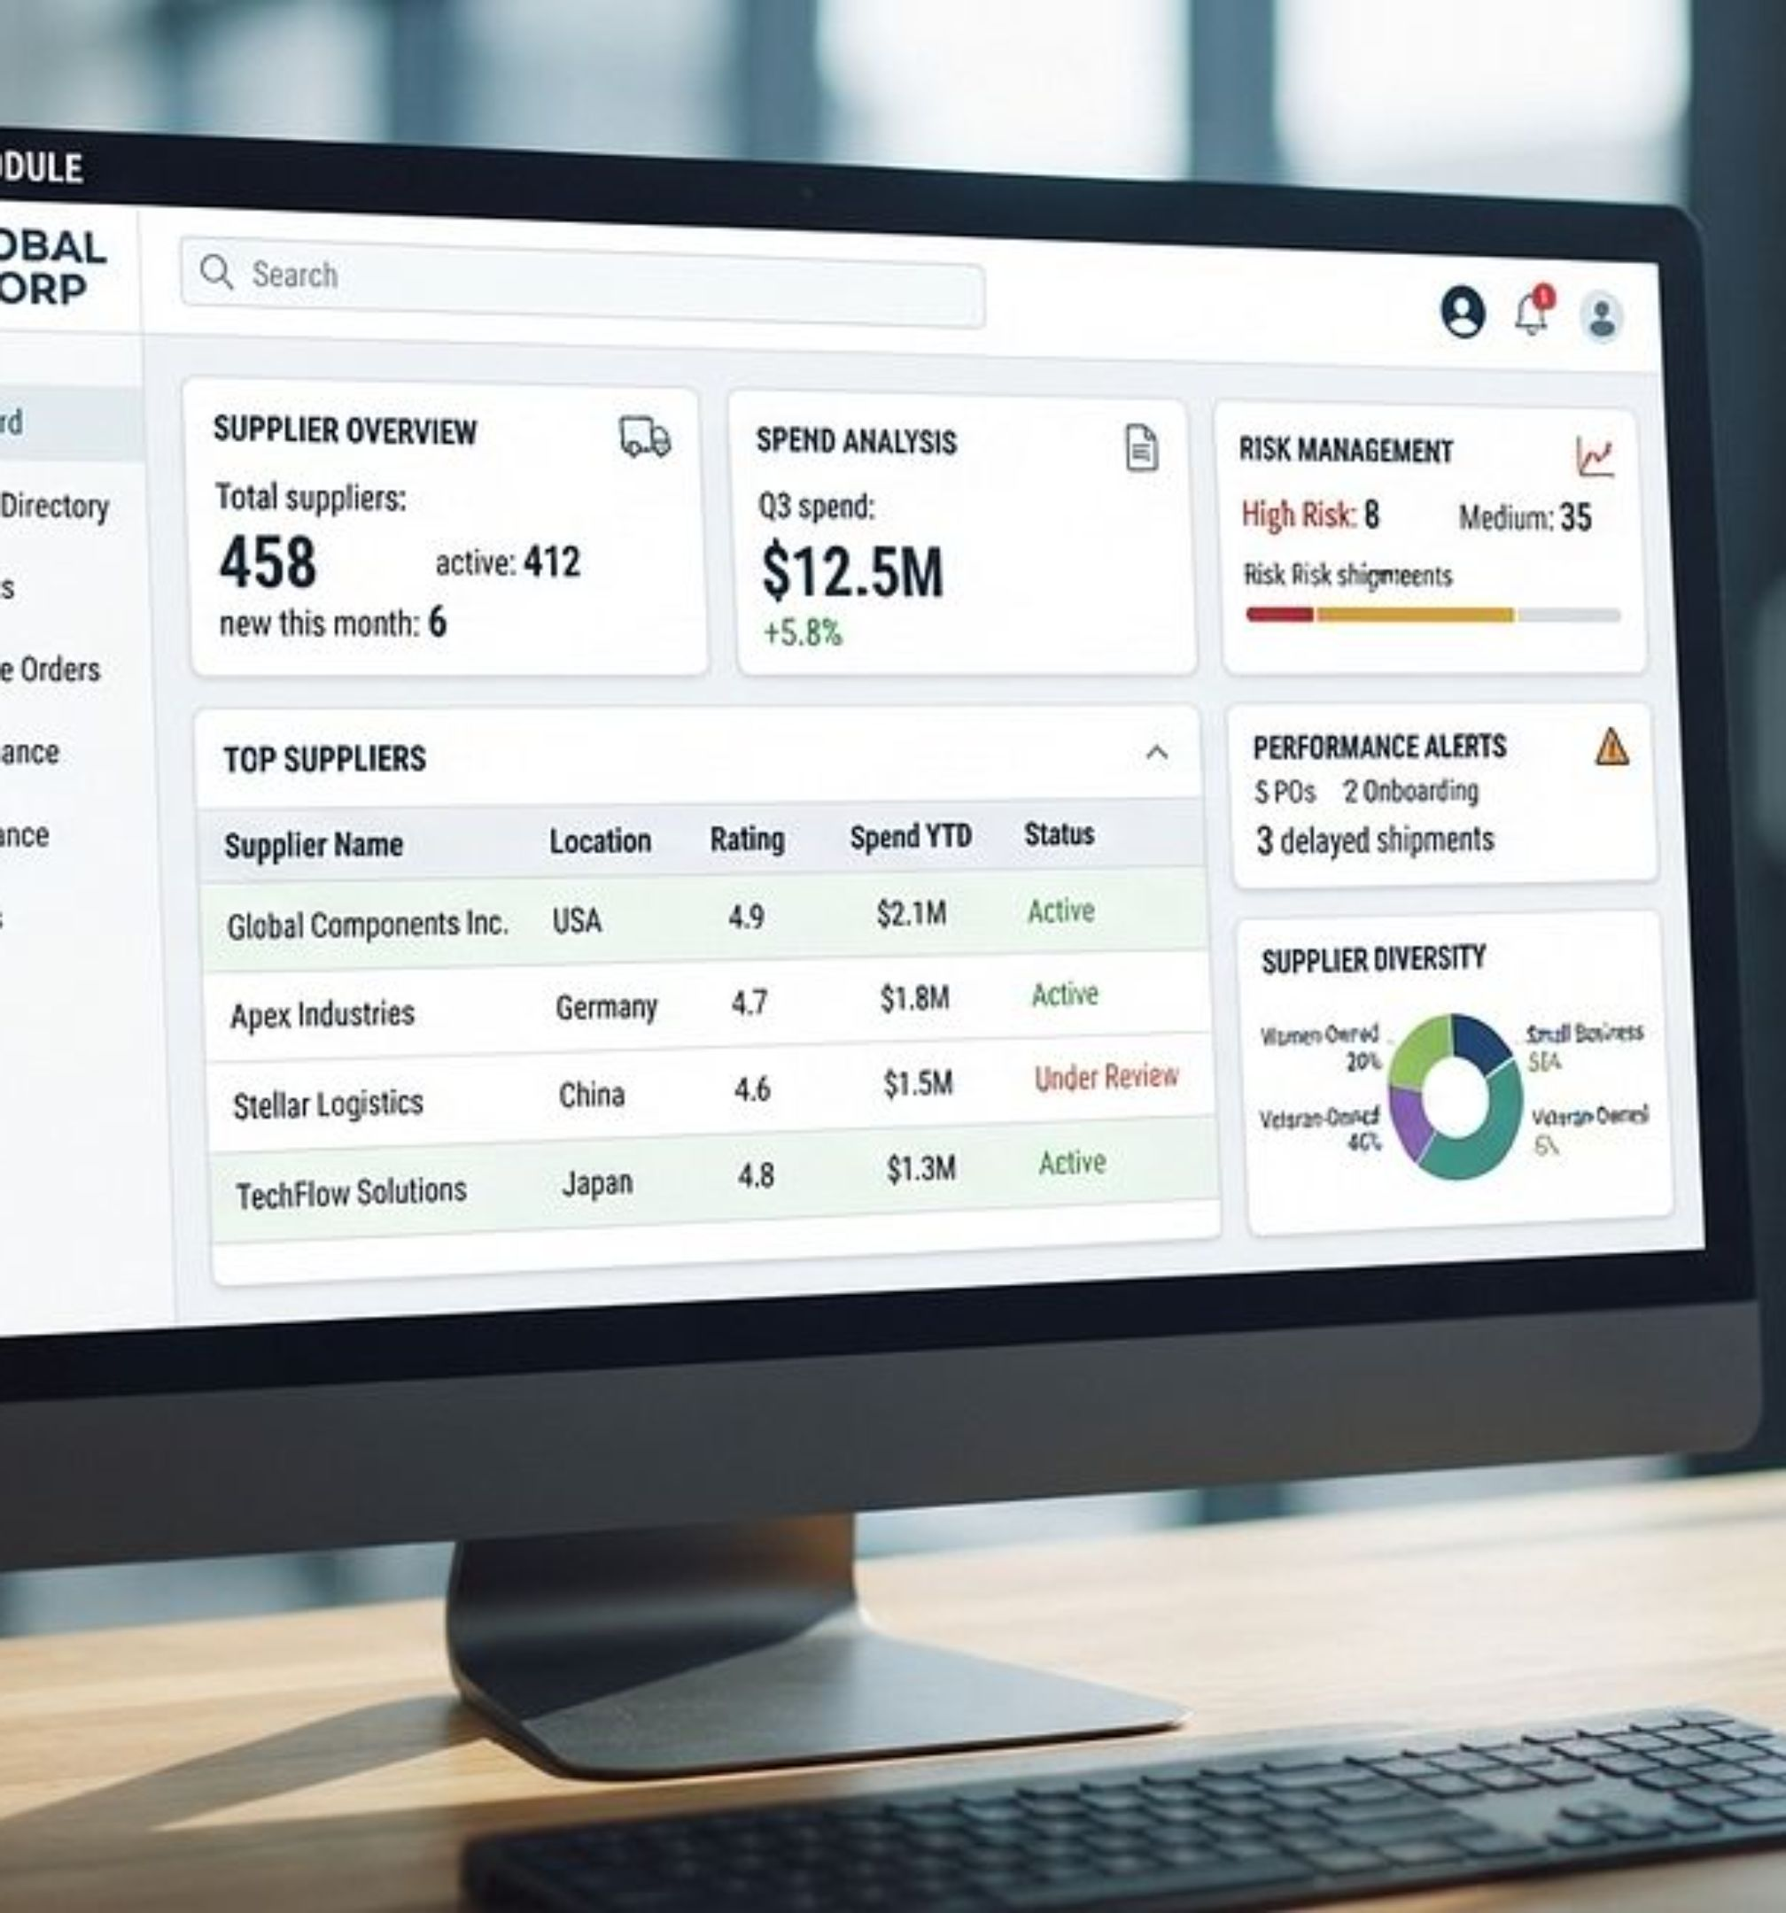
Supplier Module
Seamless integration for suppliers to receive, fulfill, and manage purchase orders efficiently.

Slide 14
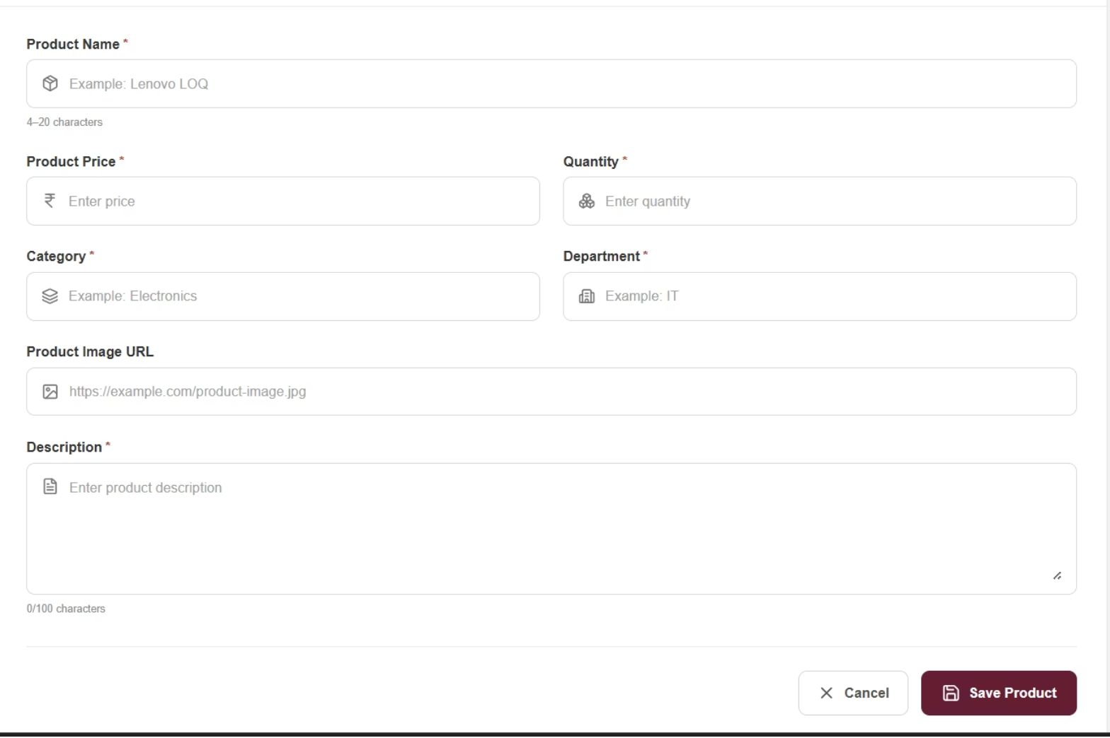
Add & Manage Products
Create product listings with name, price, quantity, category
Upload product images and detailed descriptions
Manage inventory and product specifications

Slide 15
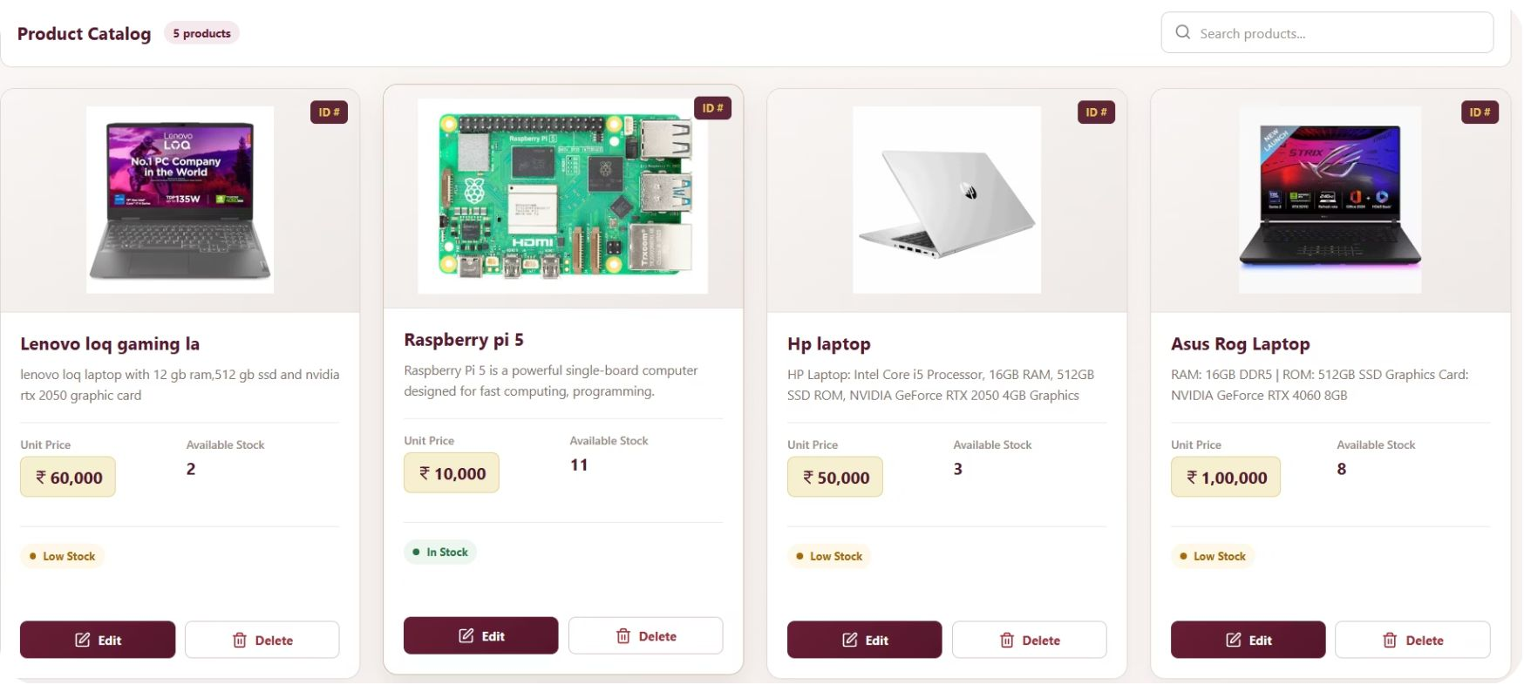
View Product Catalog & Reviews
Monitor all listed products and their performance
Track product reviews and customer ratings
Manage product visibility and availability

Slide 16
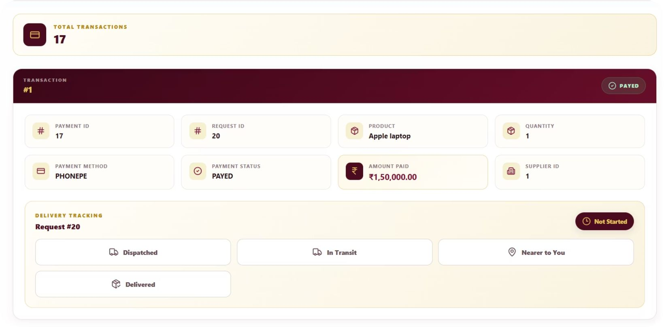
Track Request Status
Monitor request progress through the entire approval pipeline
View delivery tracking details and estimated timelines for dispatched items
Receive real-time status updates: Requested, In Review, Approved, In Transit, Delivered

Slide 17


Key Benefits & Workflow
Transparency
Efficiency
All stakeholders have real-time visibility into requests, approvals, and payments
Automated workflows reduce manual processing and approval times
Accountability
Complete audit trail with CSV reports for compliance
Scalability
Centralized system supports growing procurement needs

Slide 18
Thank You!

